Slide 1
Musical genre classification
PRESENTED BY
S.SAMSUN SUNDAR RAJ
613521104038
3rd YEAR CSE Dept

Slide 2
agenda
Problem Statement
Proposed System/Solution
System Development Approach
Algorithm & Deployment
Results
Conclusion
References

Slide 3
Problem Statement
Musical Genre Classification
The problem of musical genre classification involves automatically categorizing a piece of music into one or more predefined genres, such as rock, pop, jazz, or classical. This task is challenging due to the subjective nature of musical genres and the high variability in musical features across different genres.

Slide 4
Challenges
There are several challenges associated with musical genre classification:
Subjectivity: Musical genres are subjective and can be difficult to define precisely. Different listeners may have different interpretations of the same piece of music.
Data Variability: Musical features, such as rhythm, melody, and timbre, can vary significantly across different genres. This makes it challenging to develop a robust classification model.
Data Imbalance: The distribution of music samples across different genres is often imbalanced, with some genres having a much larger number of samples than others. This can affect the performance of classification models.

Slide 5

Proposed System/Solution
Deep Learning Techniques
Utilize deep learning algorithms such as Convolutional Neural Networks (CNNs) and Recurrent Neural Networks (RNNs) to analyze and classify musical genres.
CNNs can extract high-level features from audio spectrograms, while RNNs can capture temporal dependencies in music sequences.

Slide 6
Preprocessing and Feature Extraction
Preprocess audio data by converting it into spectrograms or other suitable representations.
Extract relevant features from the spectrograms, such as mel-frequency cepstral coefficients (MFCCs) or spectral contrast.
Model Training and Evaluation
Train the deep learning model on a large dataset of labeled music samples.
Use techniques like cross-validation and hyperparameter tuning to optimize the model's performance.
Evaluate the model's accuracy, precision, recall, and F1 score to assess its effectiveness in genre classification
Real-Time Classification
Implement the trained model in a real-time system that can classify music genres on-the-fly.
Use efficient algorithms and hardware optimizations to ensure low latency and high throughput.
Integration and Deployment
Integrate the genre classification system into music streaming platforms, recommendation engines, or other applications that can benefit from automatic genre tagging.
Deploy the system on cloud infrastructure for scalability and accessibility.

Slide 7
System Development Approach

Slide 8
Data Collection
Collect a diverse dataset of audio samples from various musical genres, ensuring a balanced representation of each genre.
Model Selection
Evaluate different deep learning models, such as Convolutional Neural Networks (CNNs) and Recurrent Neural Networks (RNNs), to identify the most suitable architecture for genre classification.
Model Evaluation
Evaluate the trained model's performance using various metrics, such as accuracy, precision, recall, and F1 score, to assess its effectiveness in genre classification.
Data Preprocessing
Clean and preprocess the collected data, including audio normalization, feature extraction, and encoding the target labels.
Model Training
Train the selected model using the preprocessed data, optimizing the model's parameters and hyperparameters to maximize classification accuracy.
System Integration
Integrate the trained model into a user-friendly application or system that allows users to classify musical genres based on audio input.

Slide 9
Algorithm & Deployment
Algorithm
The musical genre classification system is built using a deep learning algorithm, specifically a convolutional neural network (CNN).
CNNs are well-suited for image and audio processing tasks, making them ideal for genre classification based on audio features.
The algorithm is trained on a large dataset of labeled audio samples, with each sample belonging to a specific genre.
During training, the CNN learns to extract relevant features from the audio data and classify them into different genres.
The trained model achieves high accuracy in genre classification and can be used to classify new audio samples.

Slide 10
Deployment Process
Once the algorithm is trained and validated, it can be deployed in a production environment.
The deployment process involves setting up a server or cloud infrastructure to host the model and handle incoming audio samples.
The model can be exposed through an API, allowing users to send audio samples for genre classification.
The server receives the audio samples, preprocesses them, and passes them through the trained model for classification.
The predicted genre for each audio sample is then returned to the user.
The deployment process also includes monitoring the system's performance and making necessary updates or improvements as needed.

Slide 11
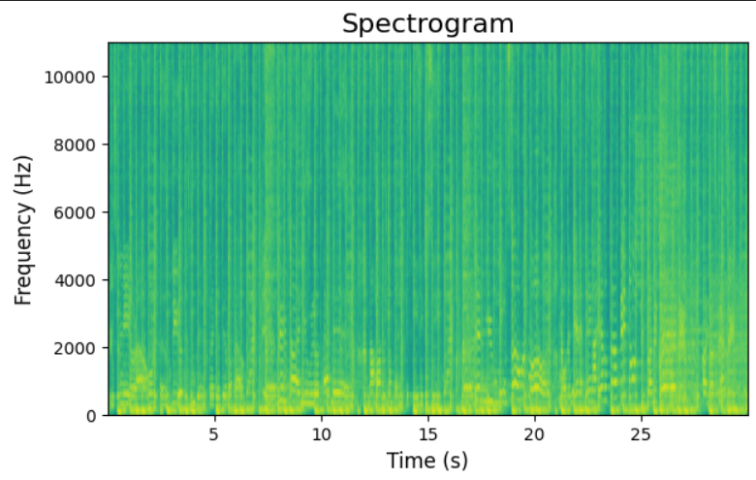
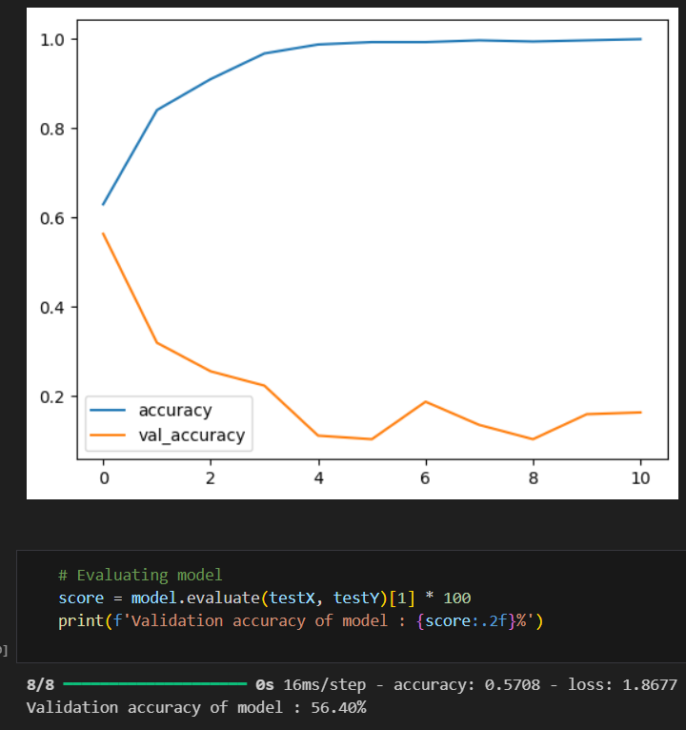
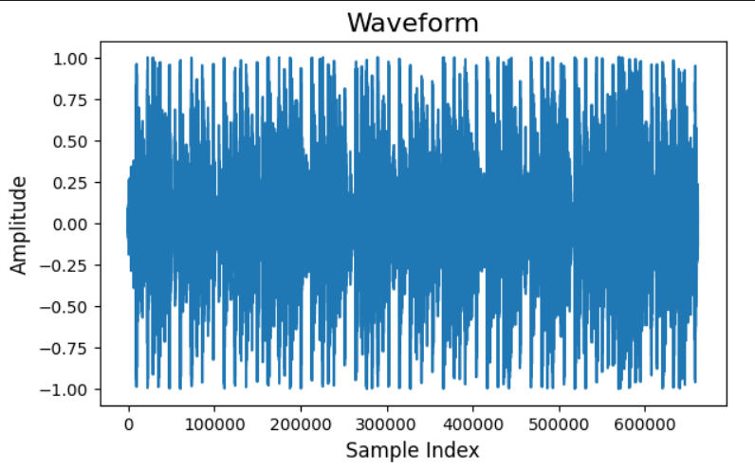
Results

Slide 12

Thank you

